Slide 1
StocKeeper
Developer: kaunghtetsan
Email: kaunghtetsan.henryzhu@gmail.com

Slide 2
objectives
To manage warehouses
To get more efficient in stock management
To access stocks data more easily
To reduce time and energy

Slide 3
Language used
Bootstrap (Front end)
Node.js, Express.js (Backend)
MySQL (database)

Slide 4
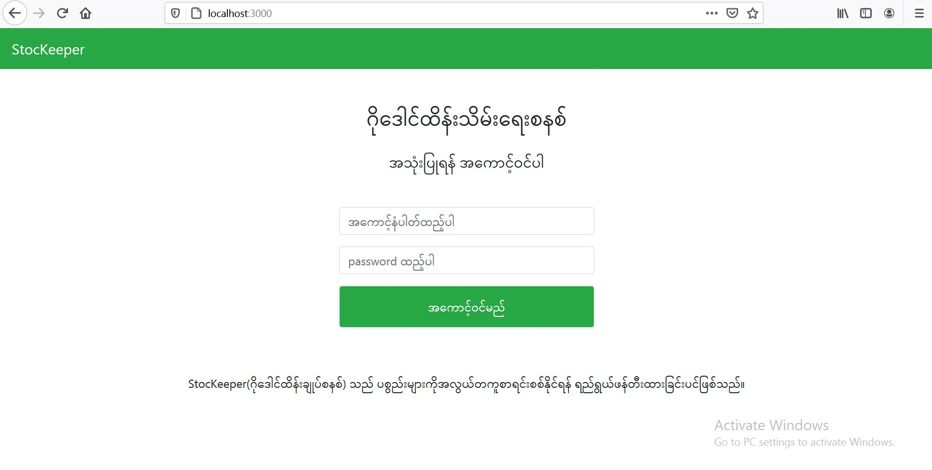
Login Form
localhost:3000 redirects to login page (account : user20, password :123)

Slide 5
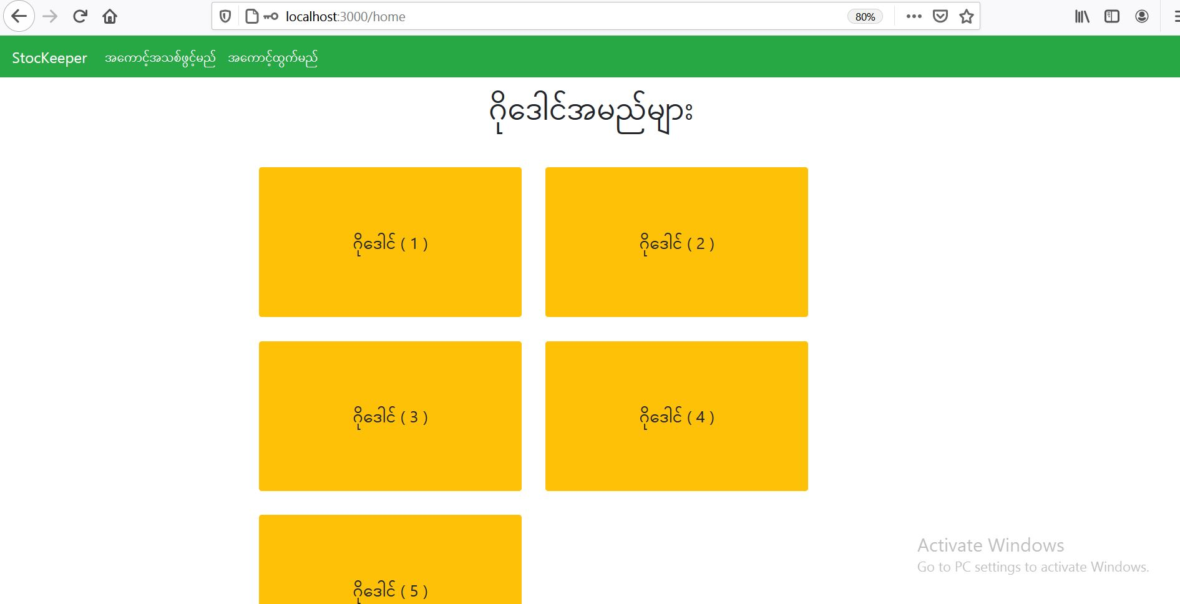
Home Page (warehouses)
warehouses are listed in this page

Slide 6
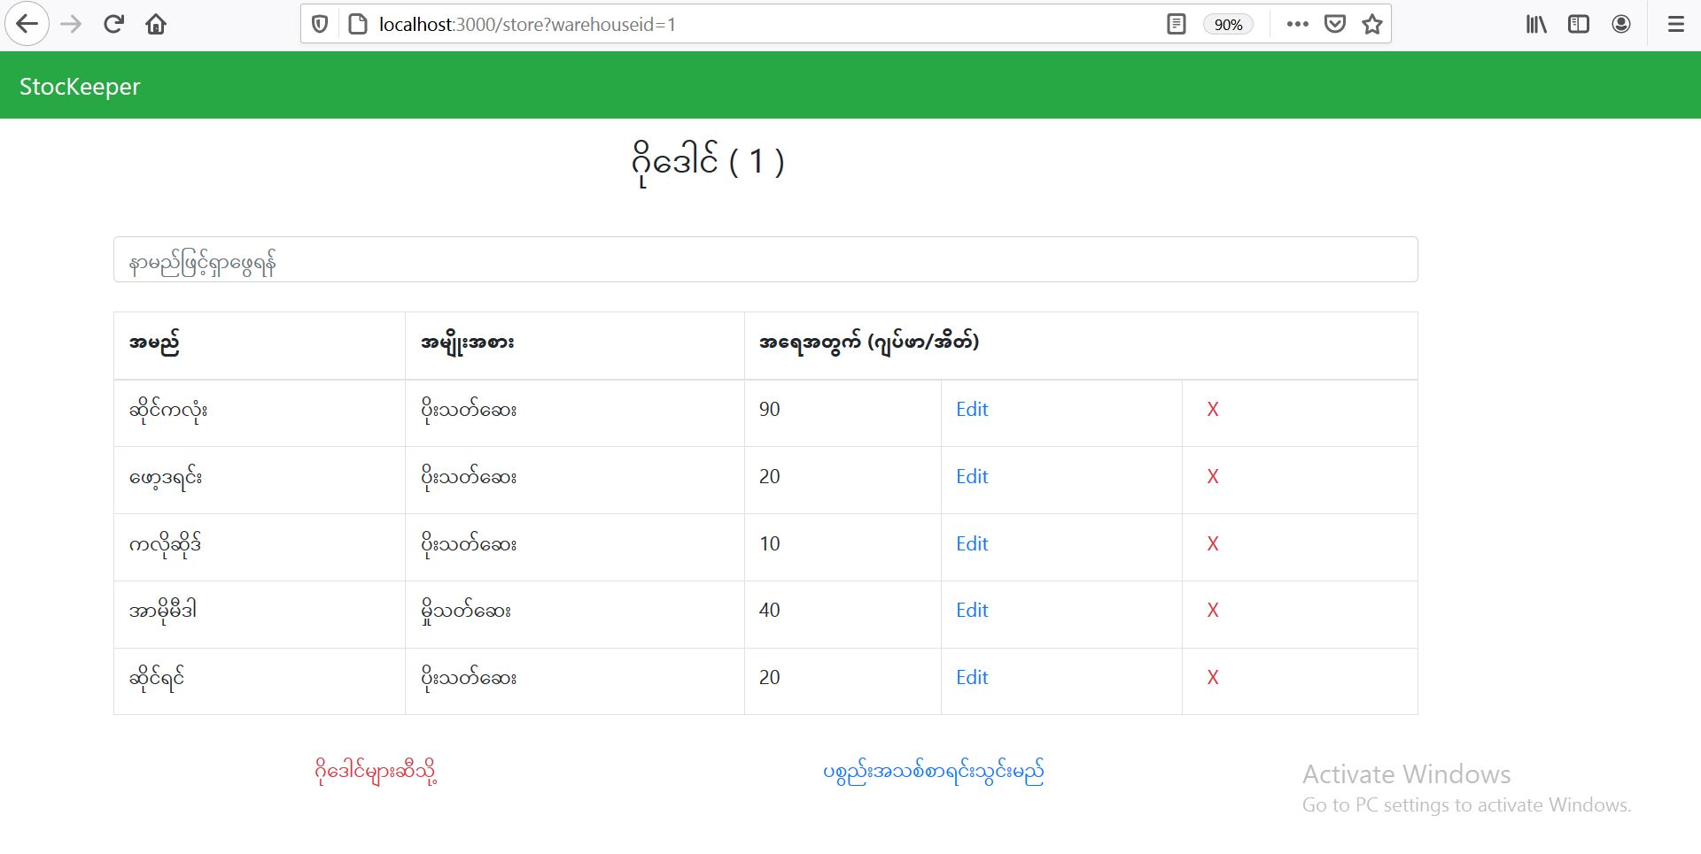
Stocks Data Page
In this page, the user can edit and delete the data

Slide 7
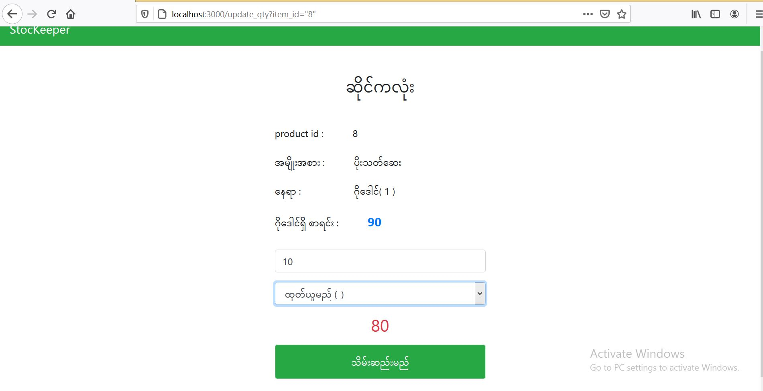
Update data
The user can add and substract the number of stocks in warehouse

Slide 8
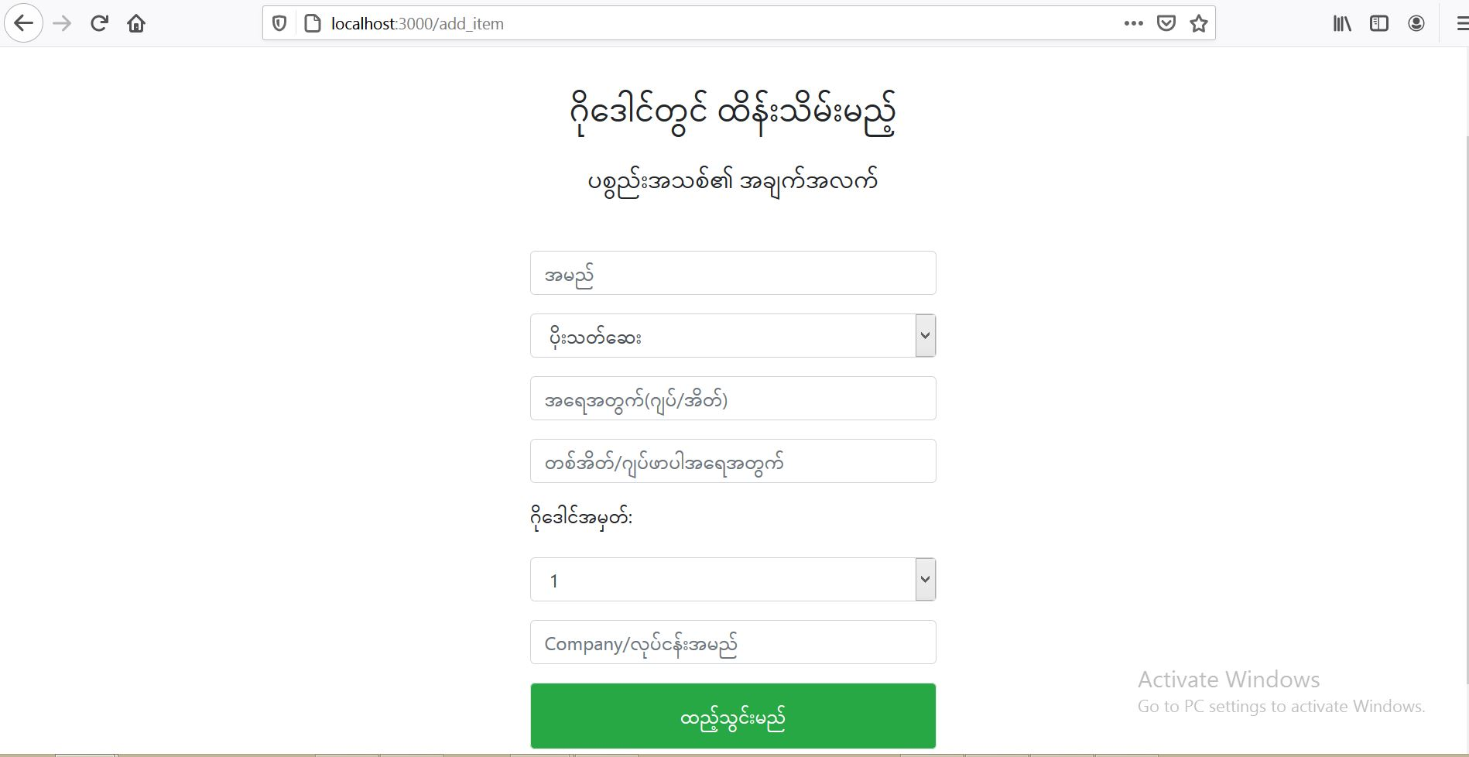
Add new stock
Fill the details of stocks to add in warehouse

Slide 9
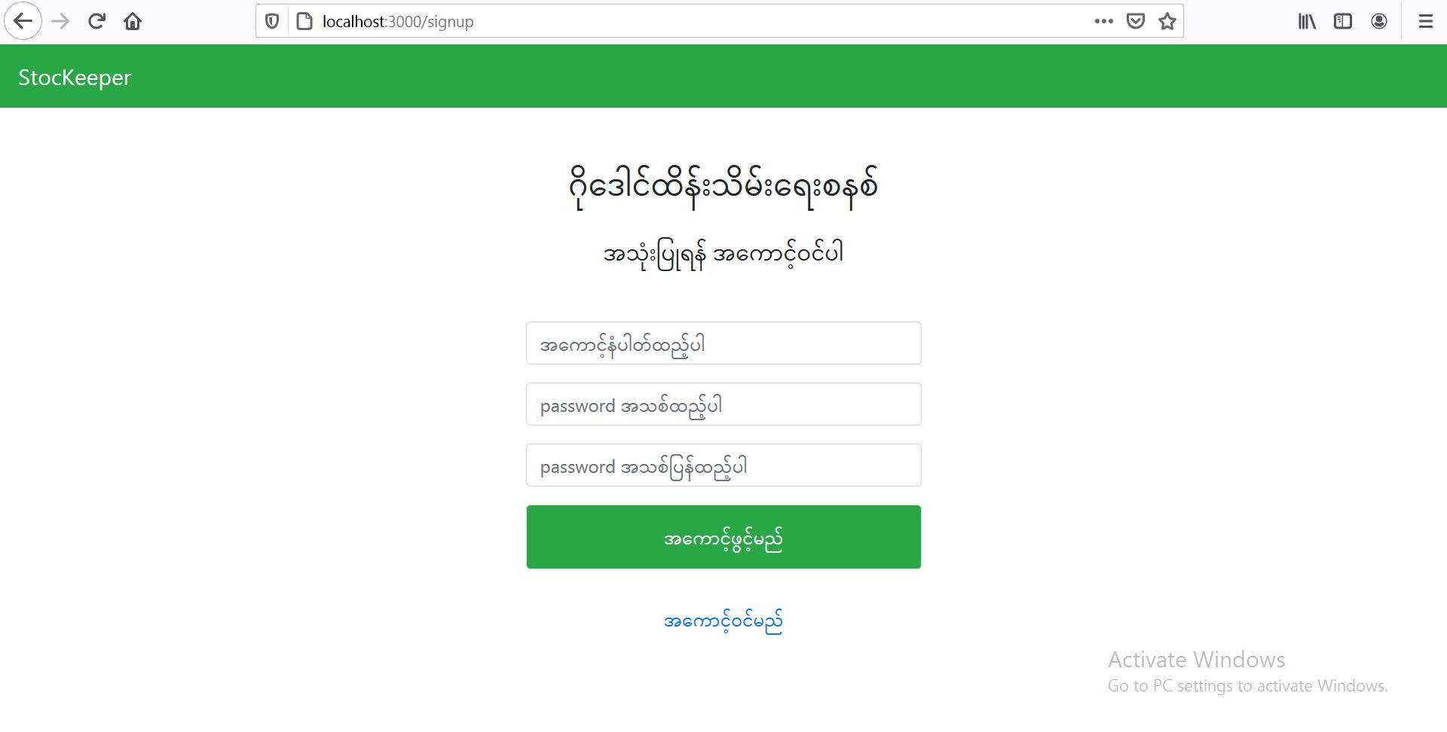
Signup account

Slide 10
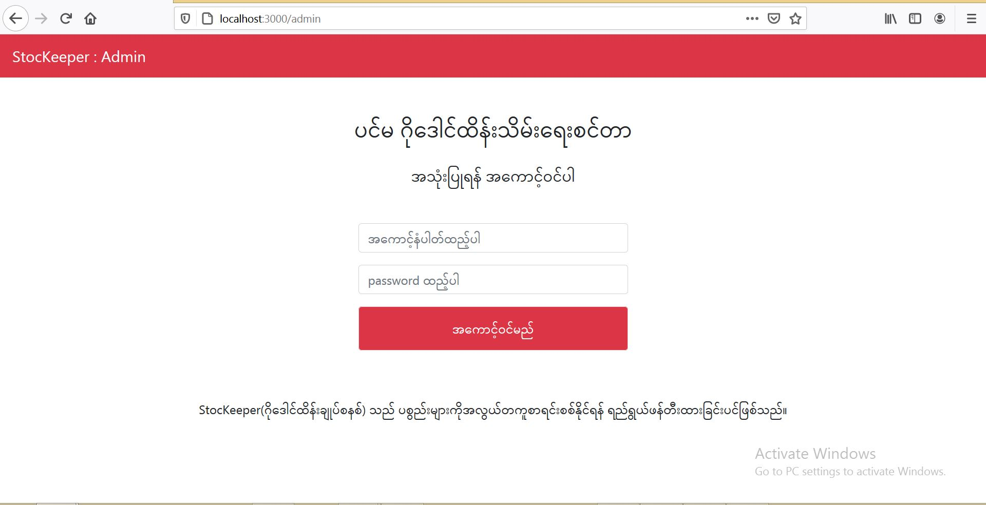
Admin login
localhost:3000 redirects to login page

Slide 11
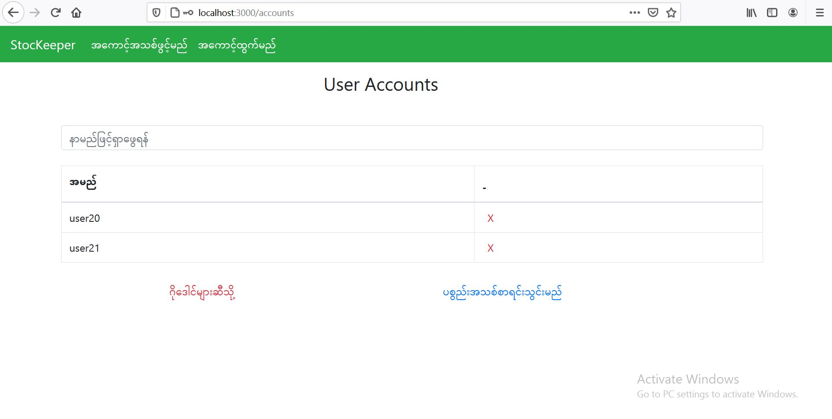
accounts
Only admin can view and edit accounts page

Slide 12
Thank you for your attention

